Slide 1
# m.O.O.S.E. #

Slide 2
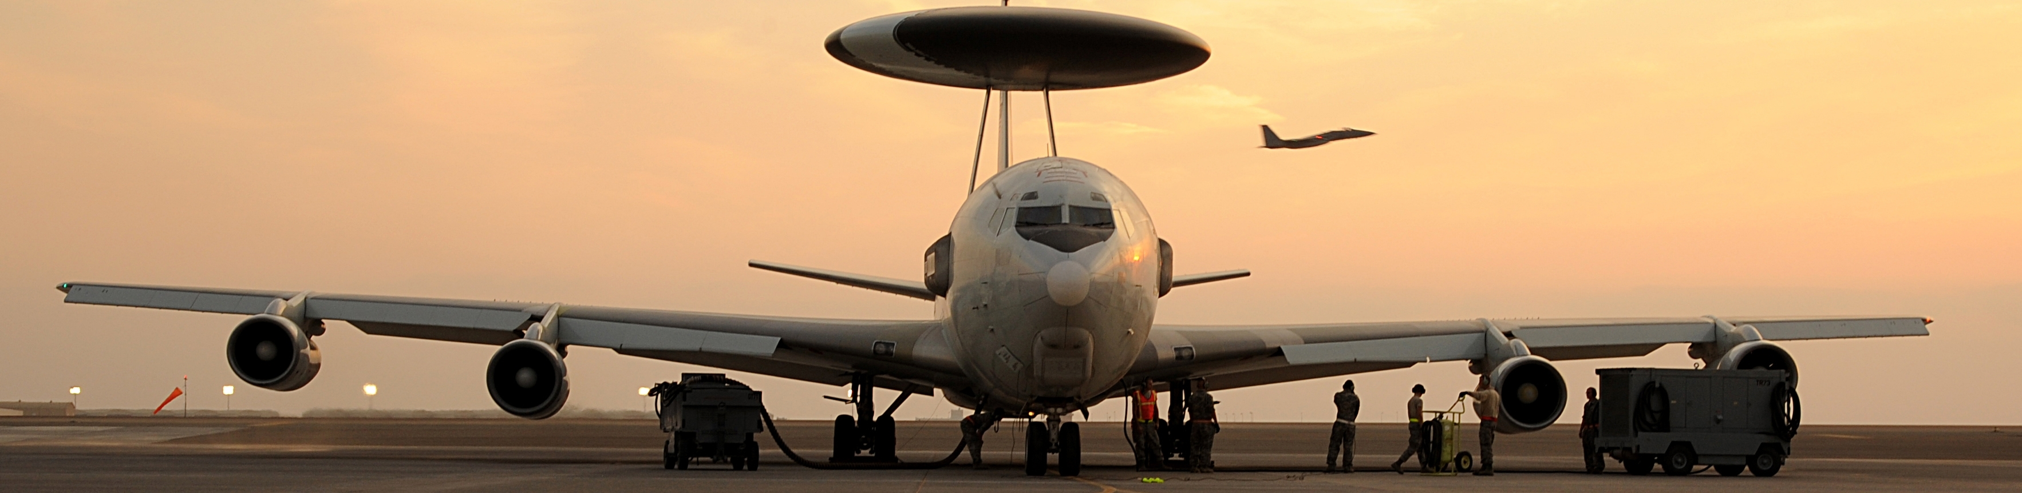
ai - air to air dispatching

Slide 3
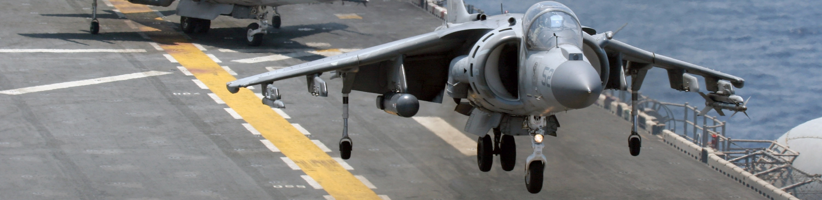
ai - air patrolling

Slide 4
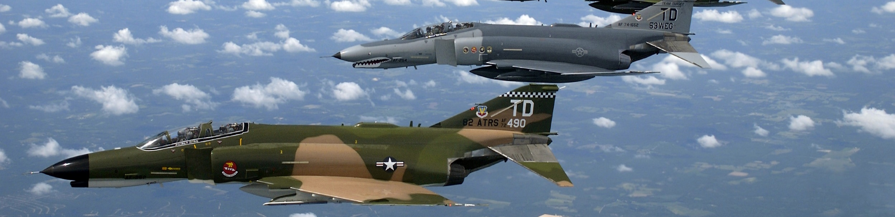
ai - combat air patrol (cap)

Slide 5
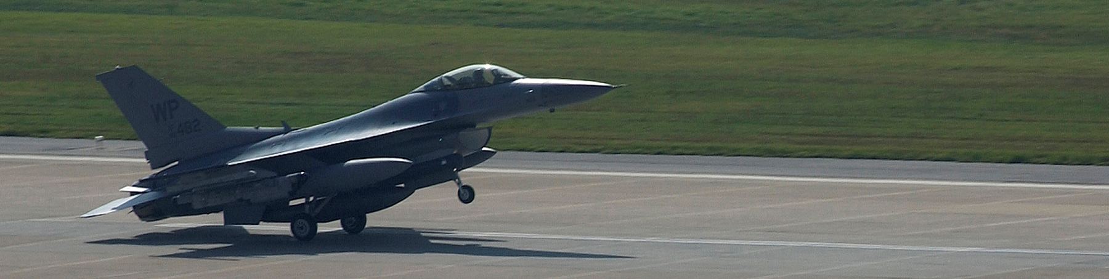
ai - ground control intercept (gci)

Slide 6

ai - close air support (cas)

Slide 7
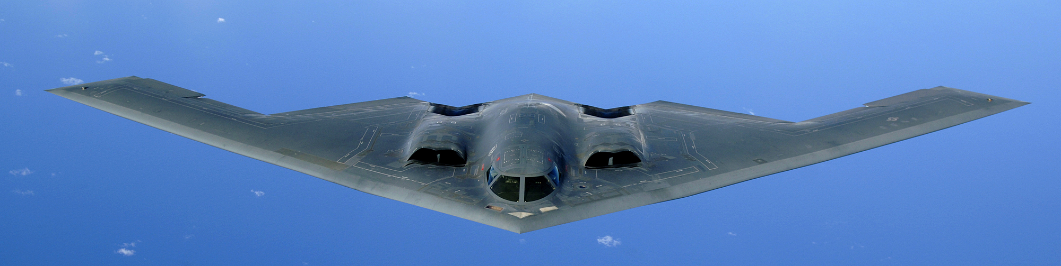
ai - battlefield air interdiction (bai)

Slide 8

ai - balancing

Slide 9
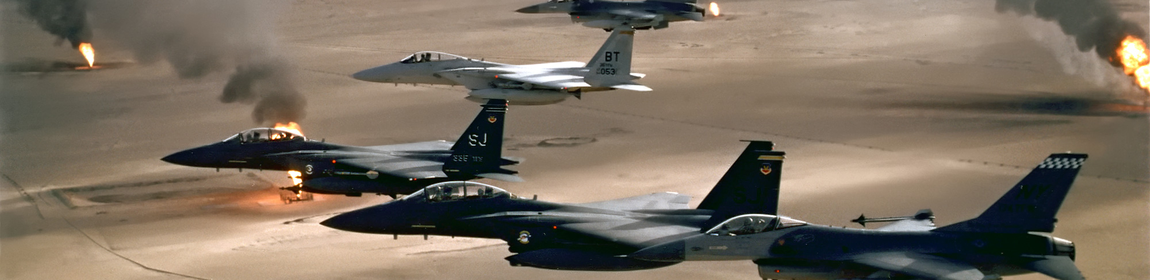
ai - large formations

Slide 10
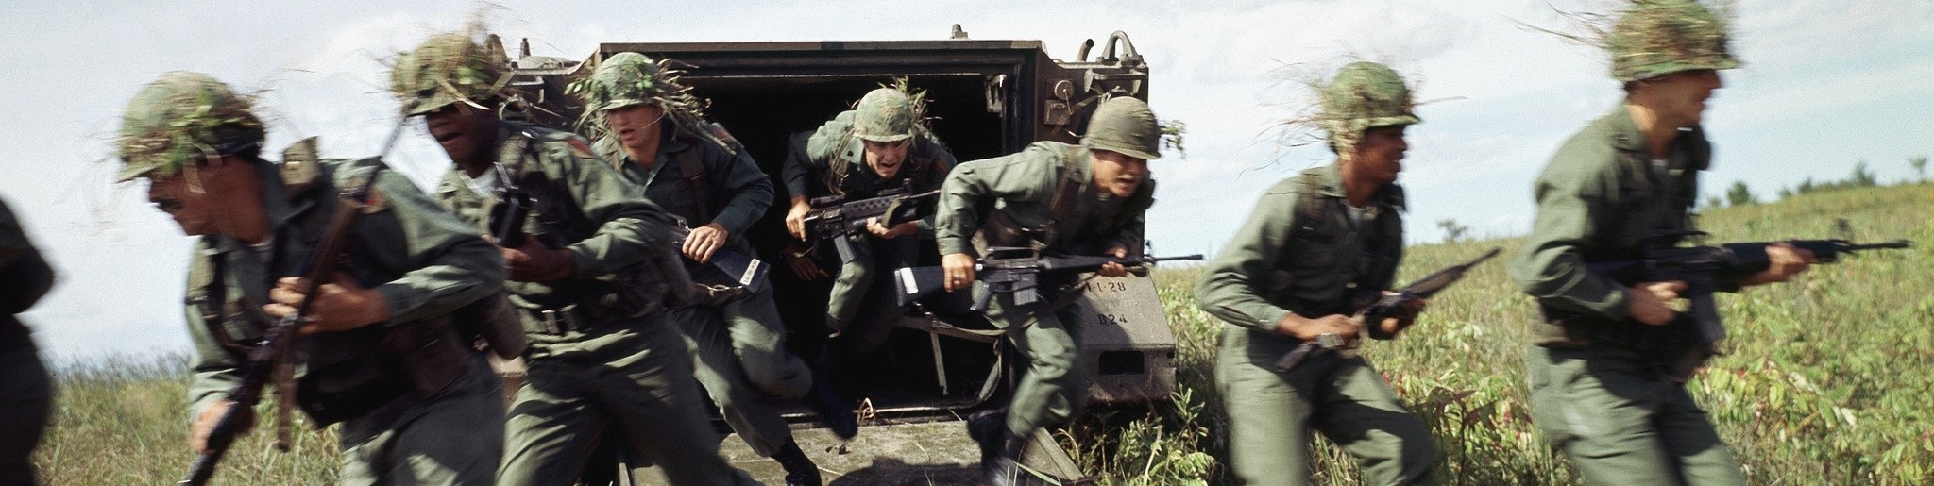
ai - cargo dispatching for apc

Slide 11
ai - cargo dispatching

Slide 12
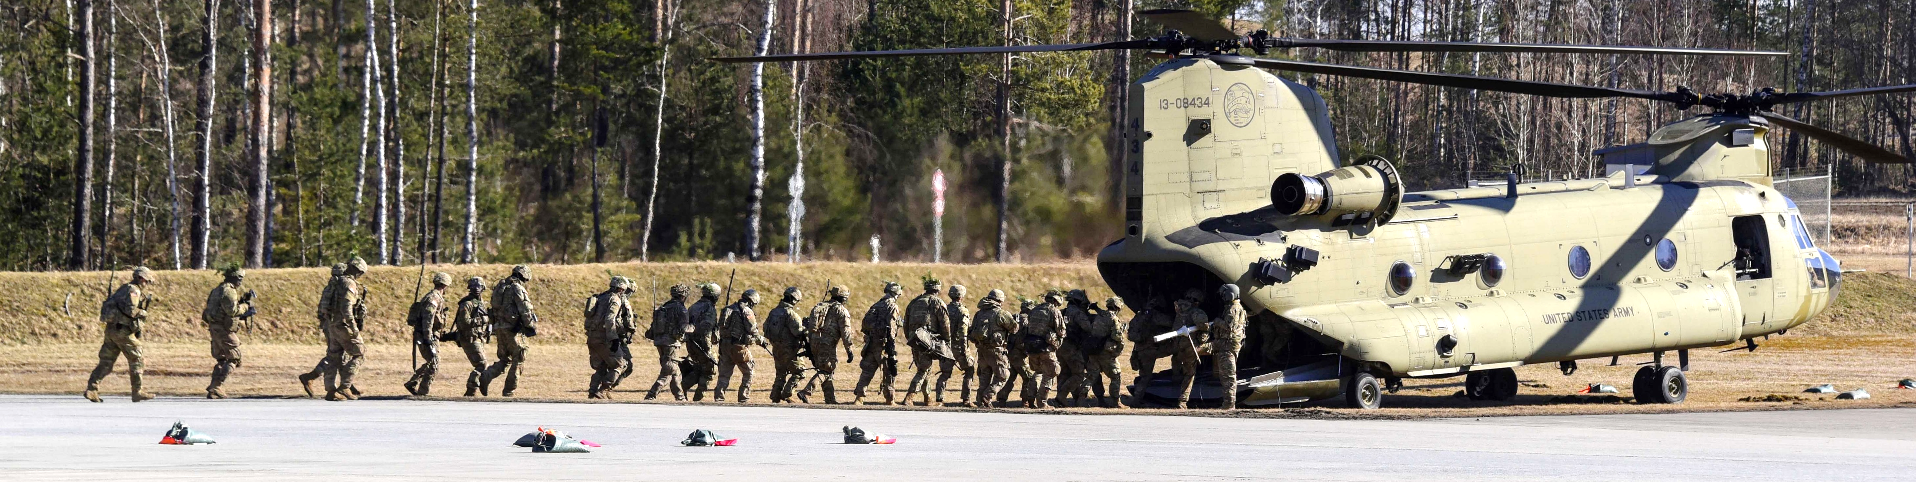
ai - cargo dispatching for helicopters

Slide 13
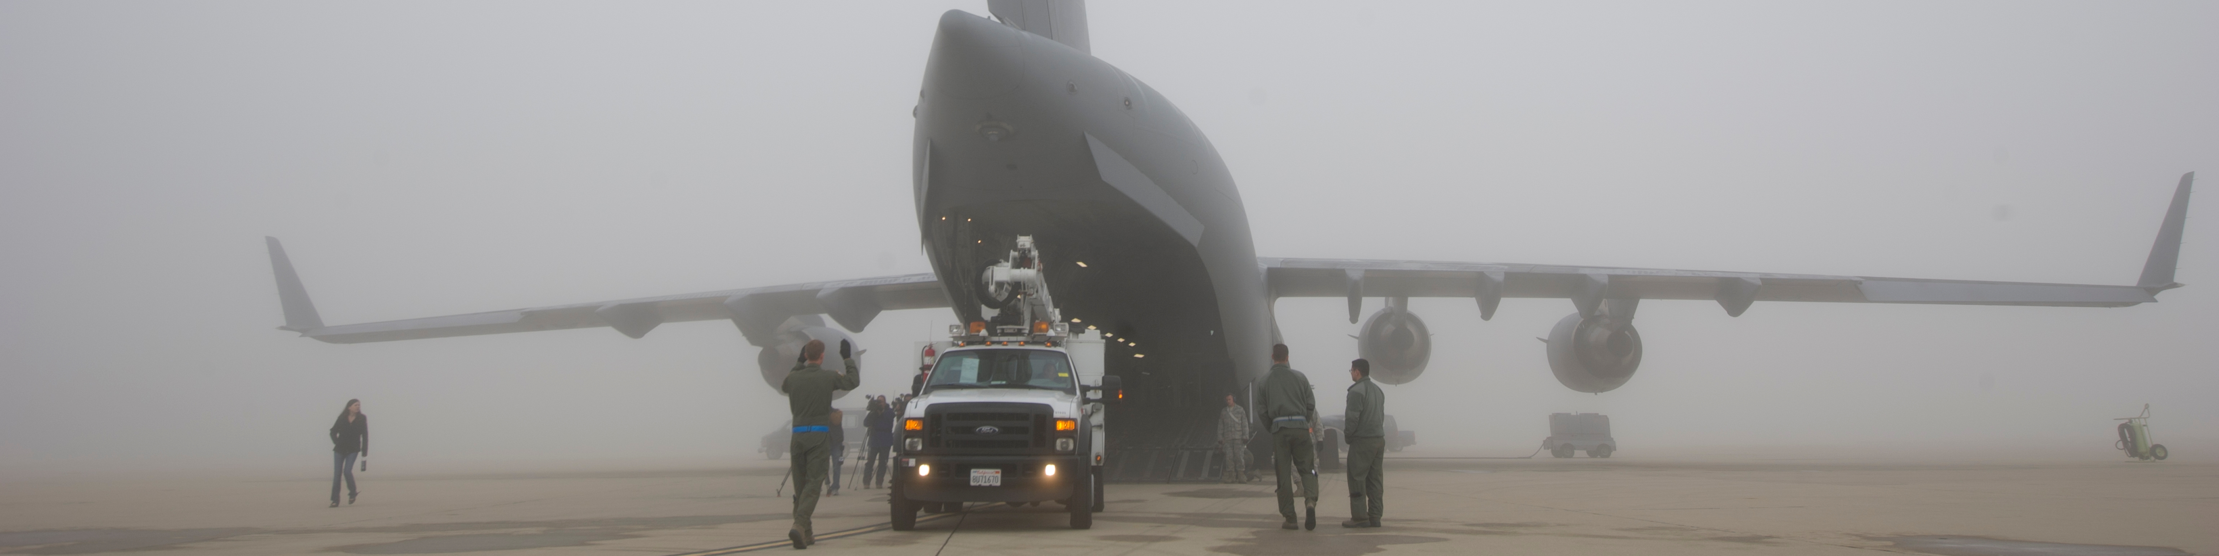
ai - cargo dispatching for airplanes

Slide 14
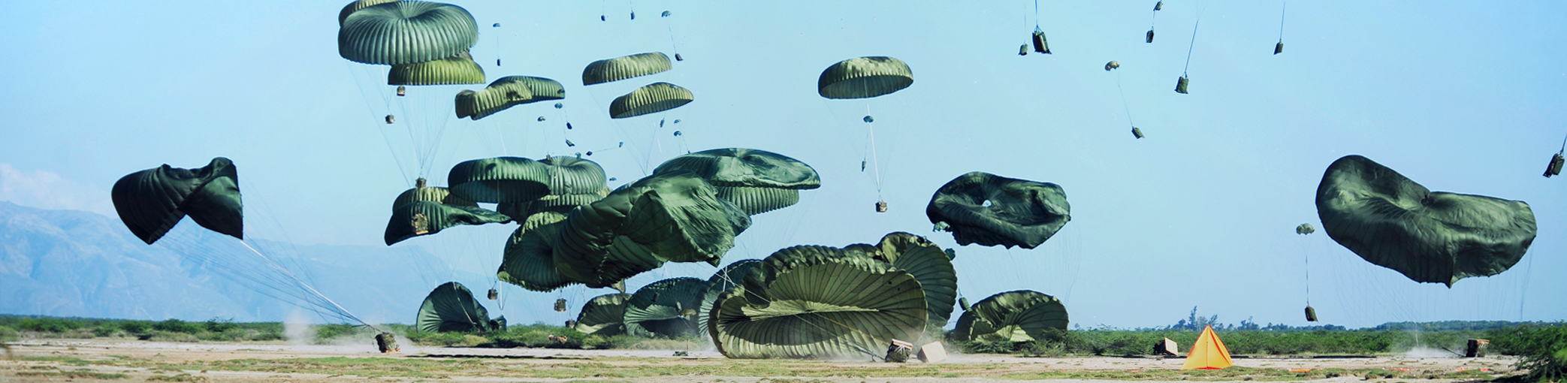
cargo

Slide 15
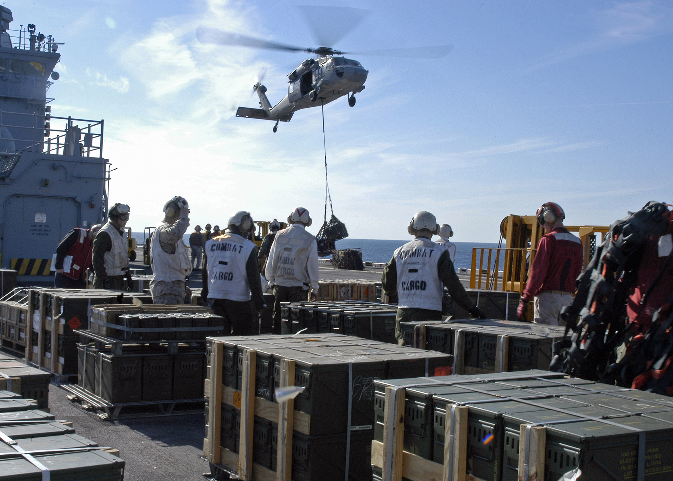
carge - crates

Slide 16
cargo - slingload

Slide 17
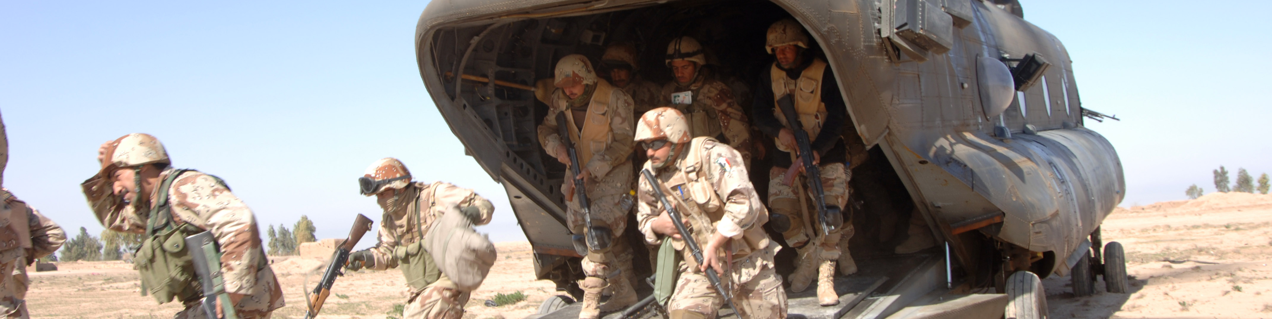
cargo - groups

Slide 18
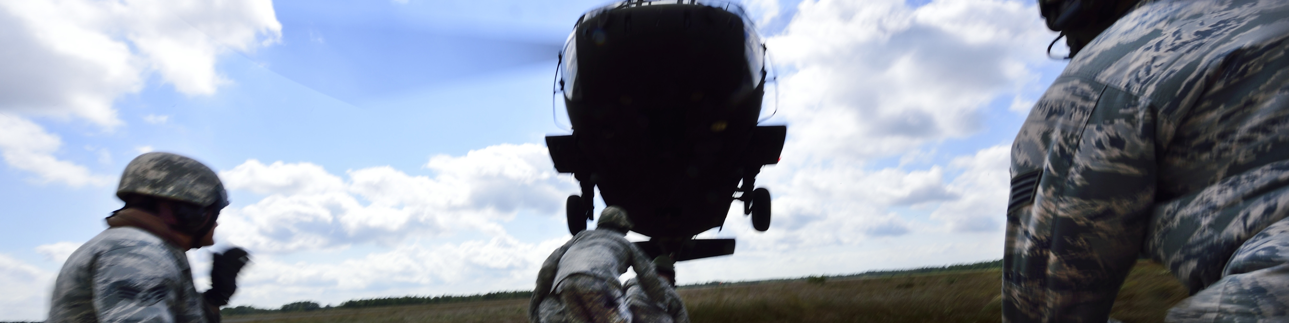
cargo - units

Slide 19
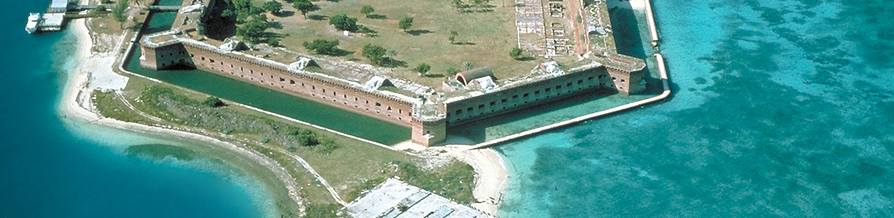
core - base

Slide 20

core - database

Slide 21
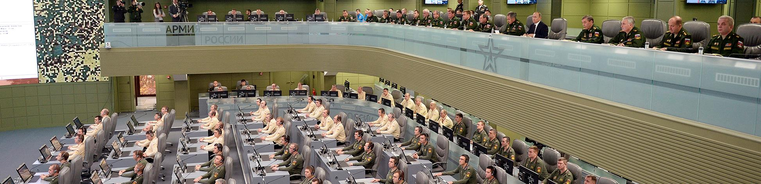
core - event

Slide 22
core - finite state machine

Slide 23
core - goal

Slide 24
core - menu

Slide 25
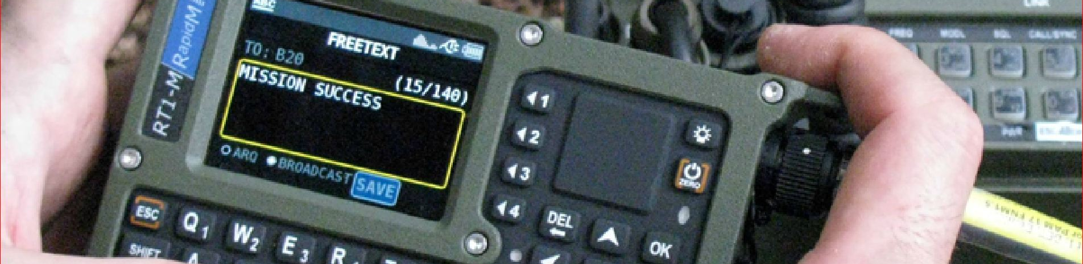
core - message

Slide 26

core - coordinate

Slide 27
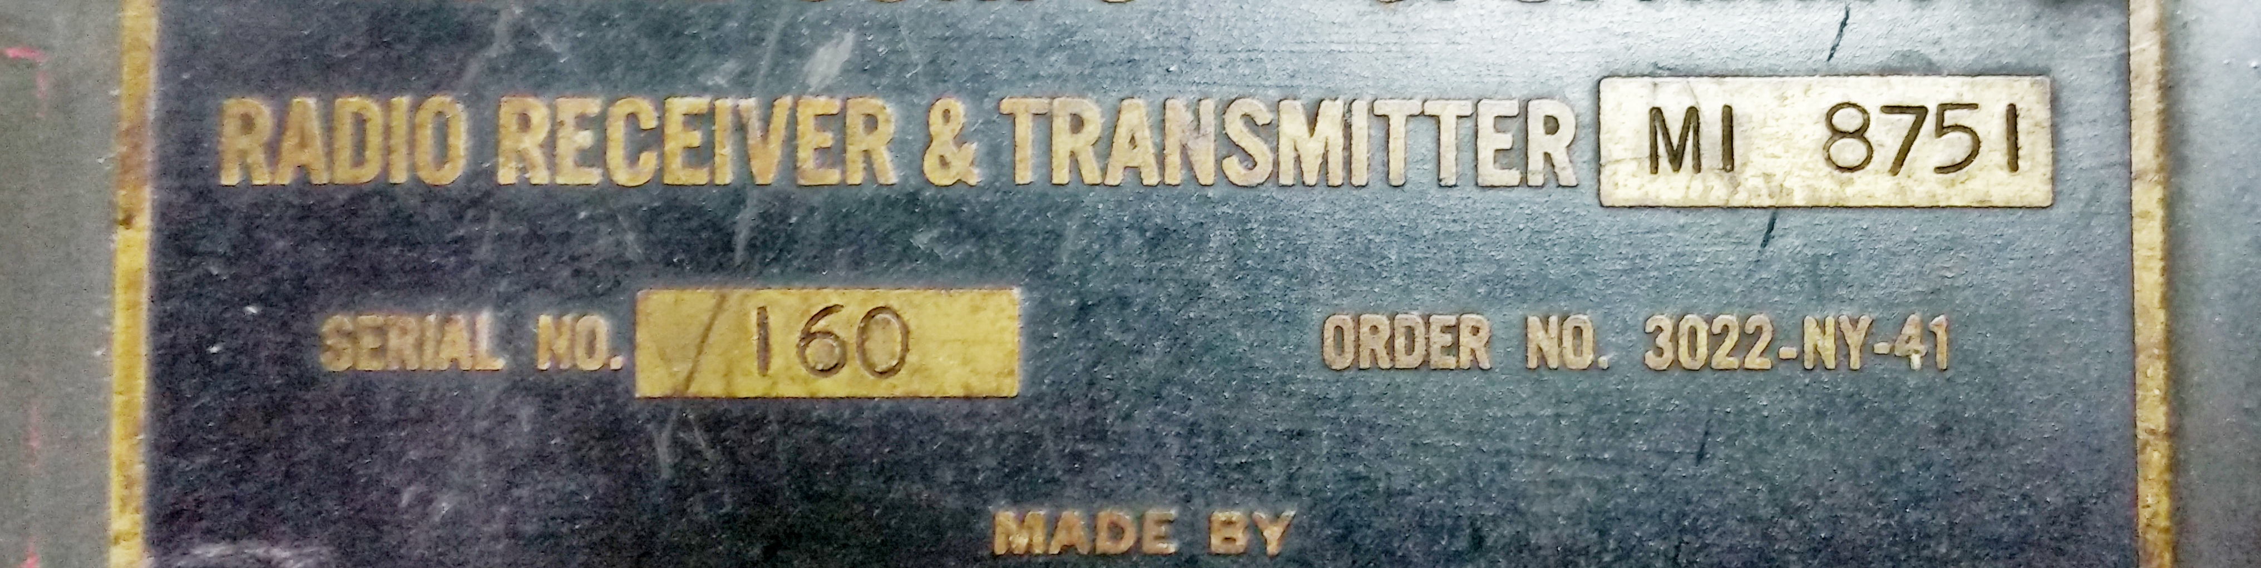
core - radio

Slide 28
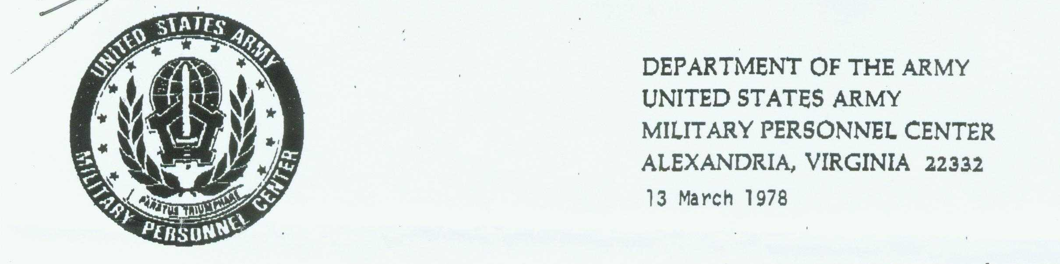
core - report

Slide 29
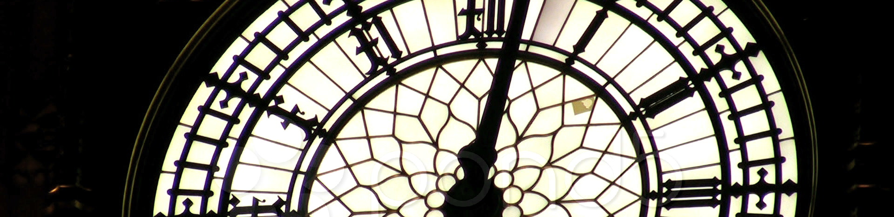
core - schedule dispatcher

Slide 30
core - scheduler

Slide 31
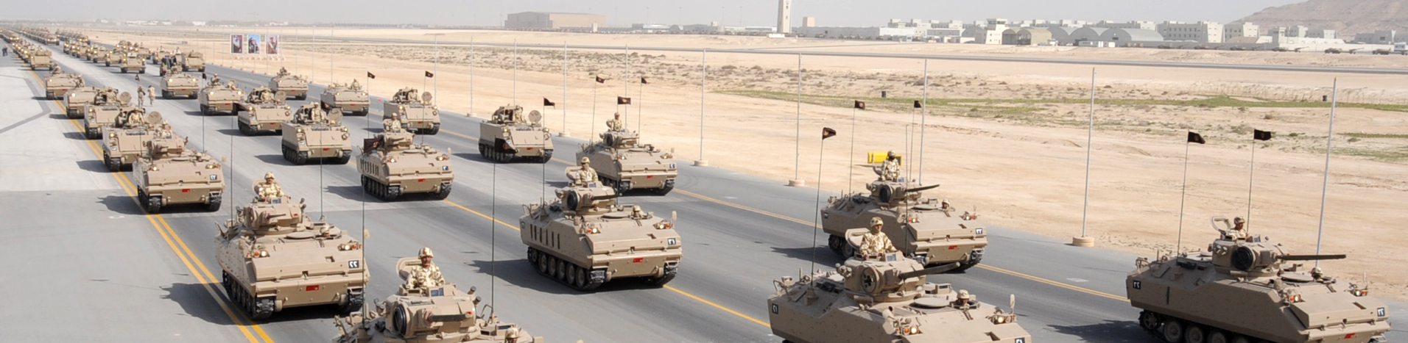
core - sets

Slide 32

core - settings

Slide 33
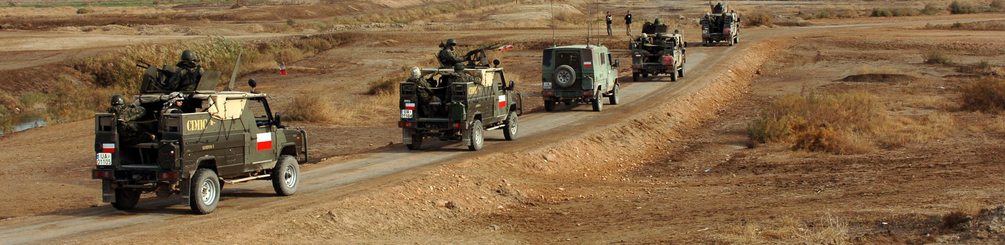
core - spawn

Slide 34
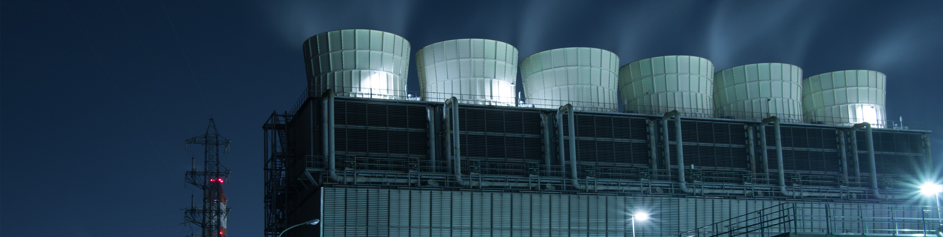
core - spawnstatic

Slide 35
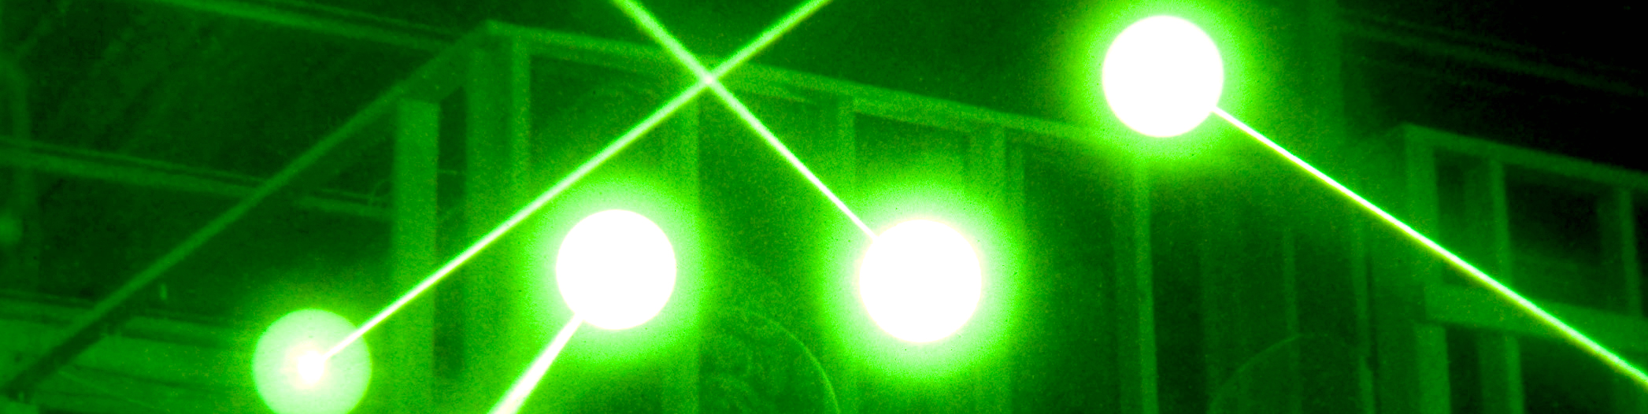
core - spot

Slide 36
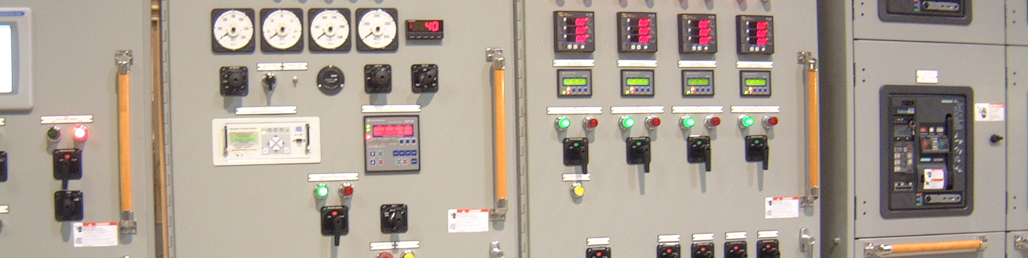
core - userflag

Slide 37
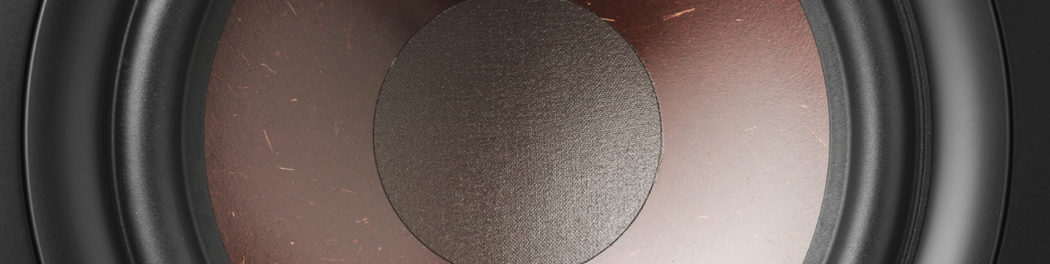
core - usersound

Slide 38
core - velocity

Slide 39
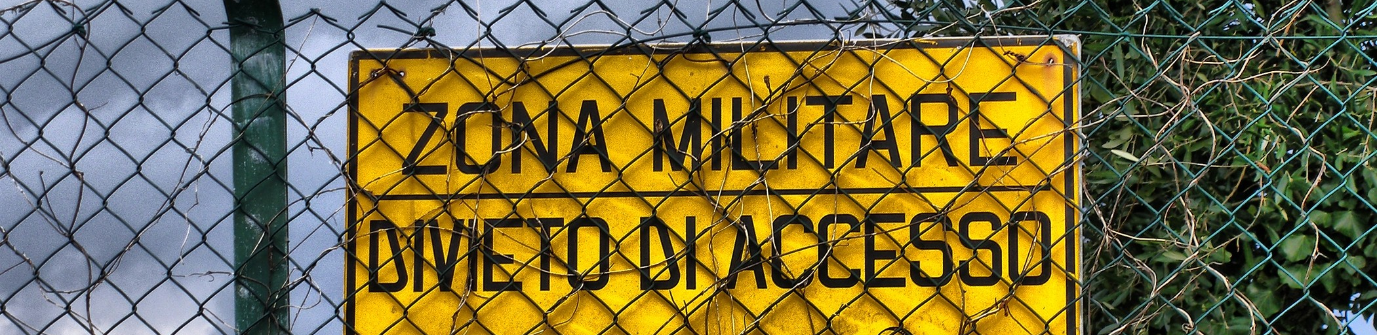
core - zones

Slide 40
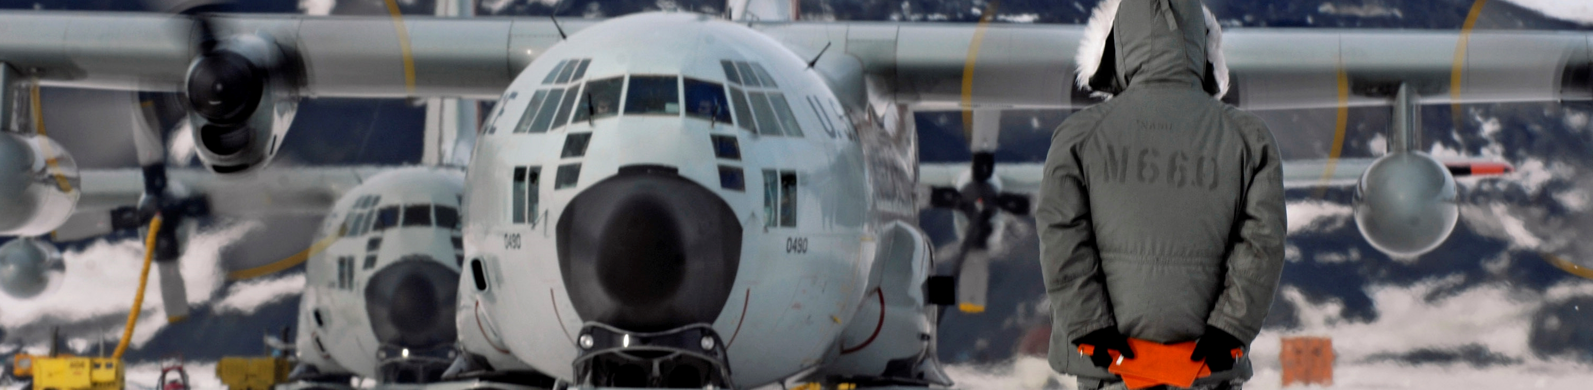
atc ground operations

Slide 41
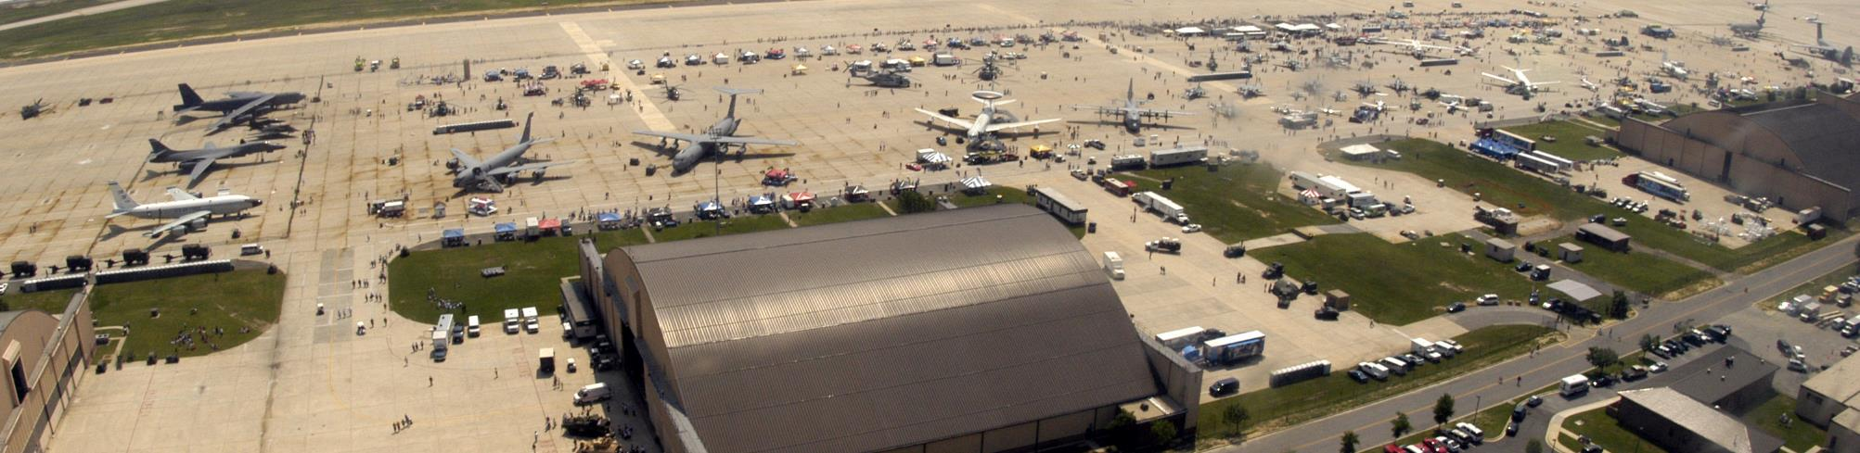
cleanup airbases

Slide 42
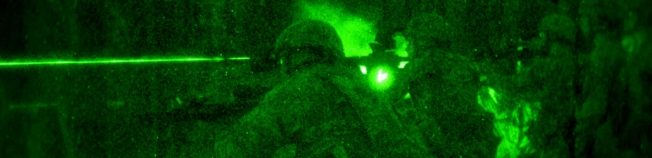
designation

Slide 43
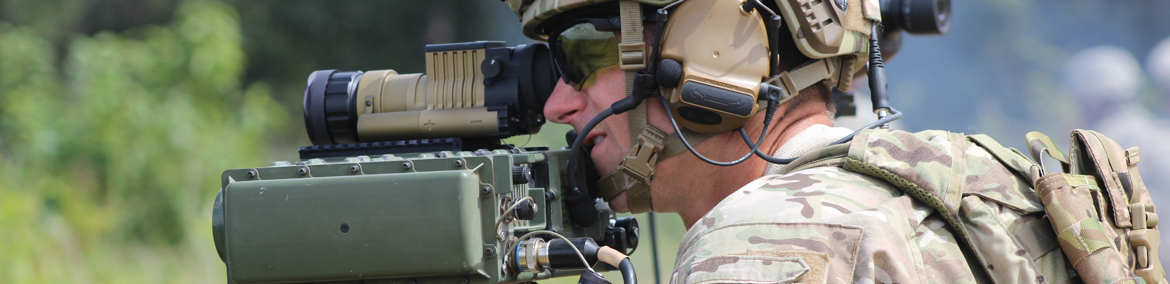
detection

Slide 44
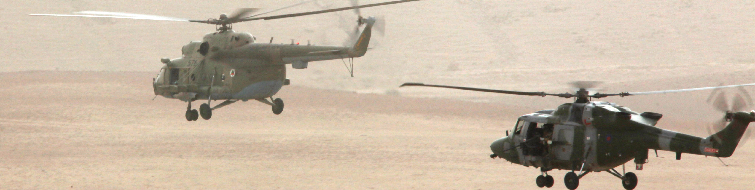
escorting

Slide 45
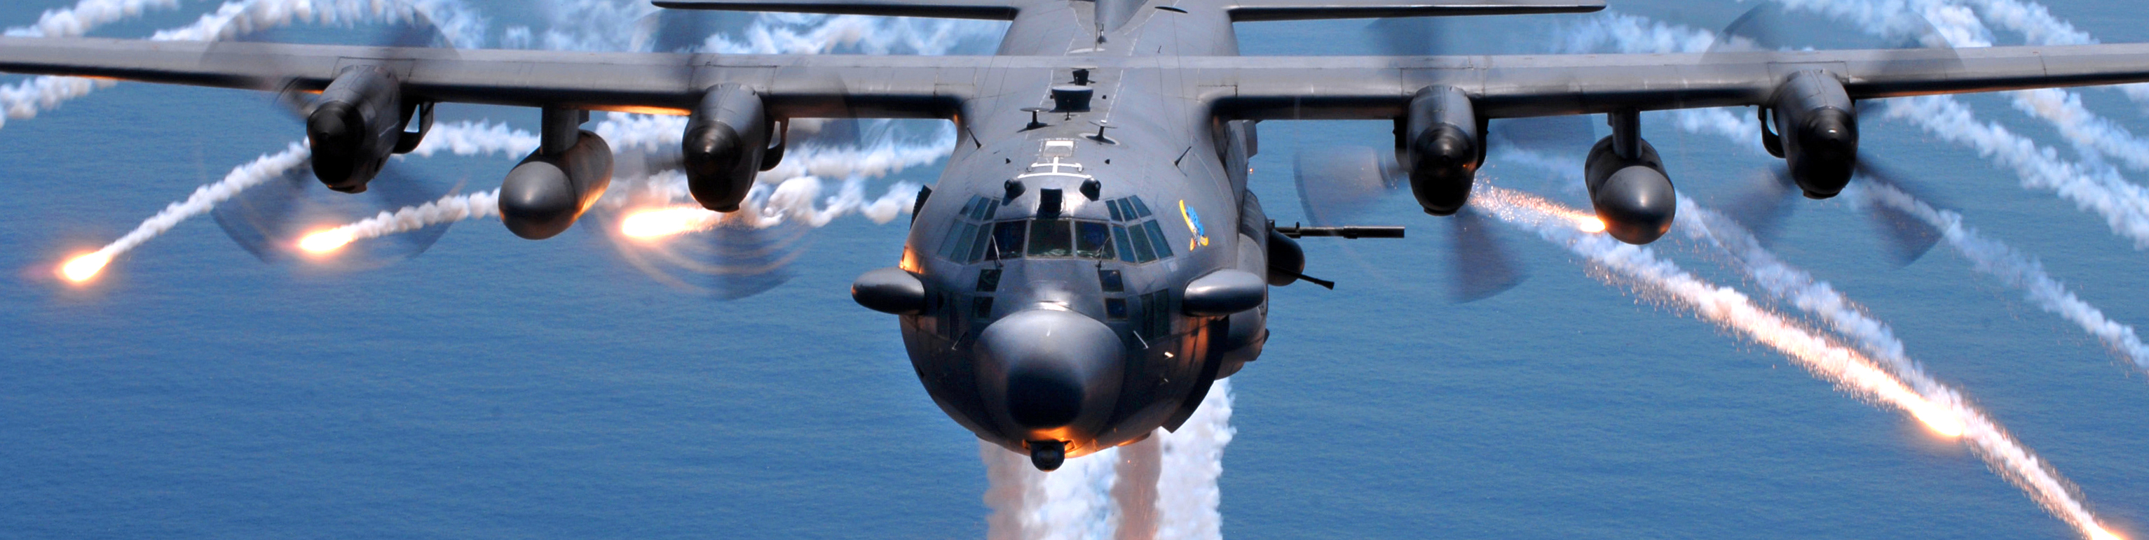
missile trainer

Slide 46
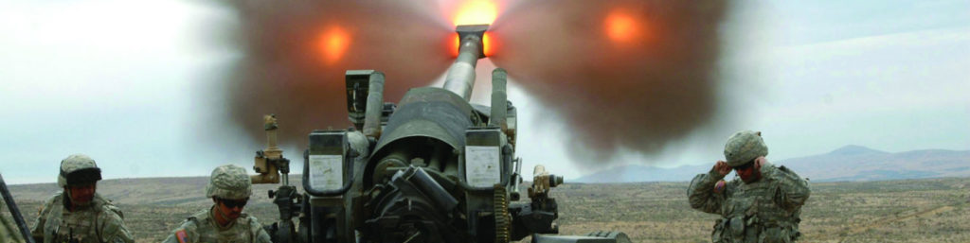
artillery

Slide 47
pseudo atc

Slide 48
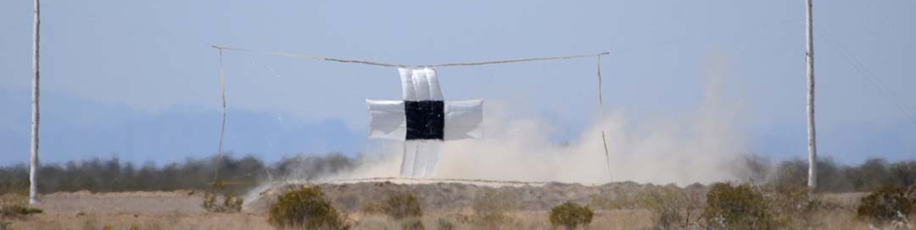
range

Slide 49
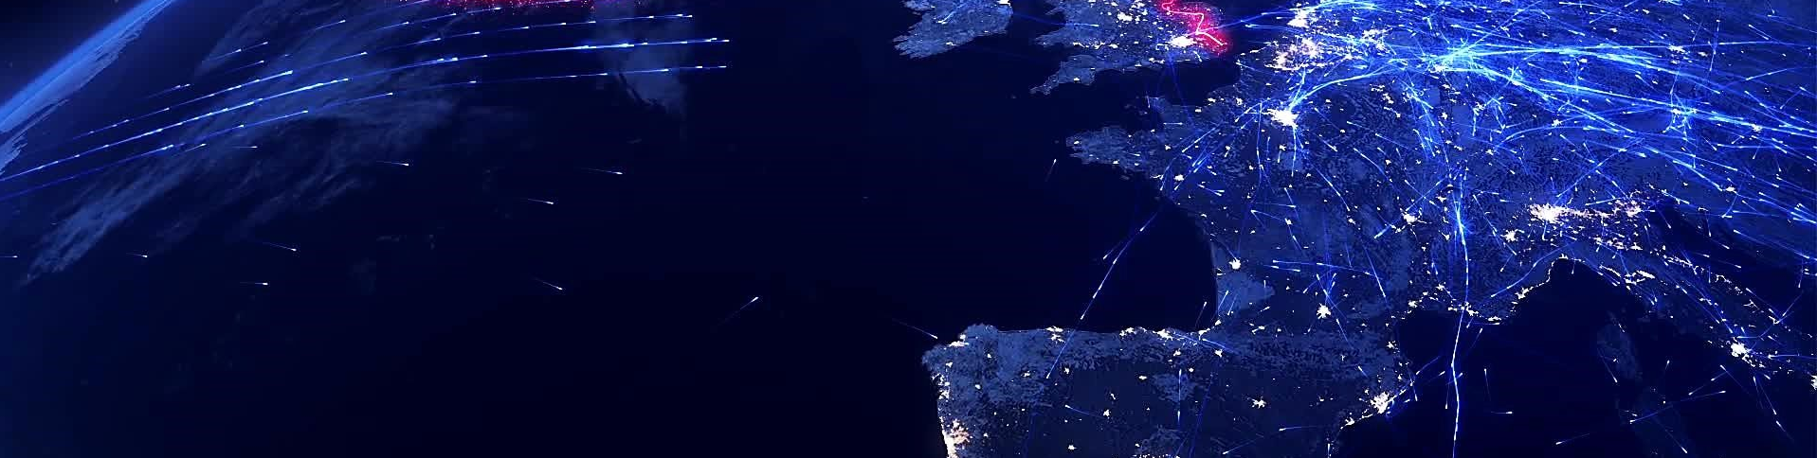
random air traffic

Slide 50
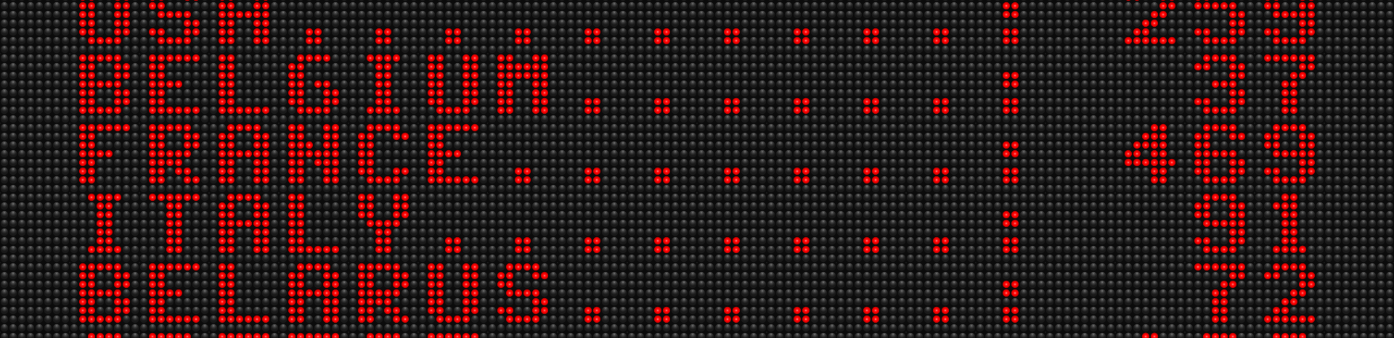
scoring

Slide 51
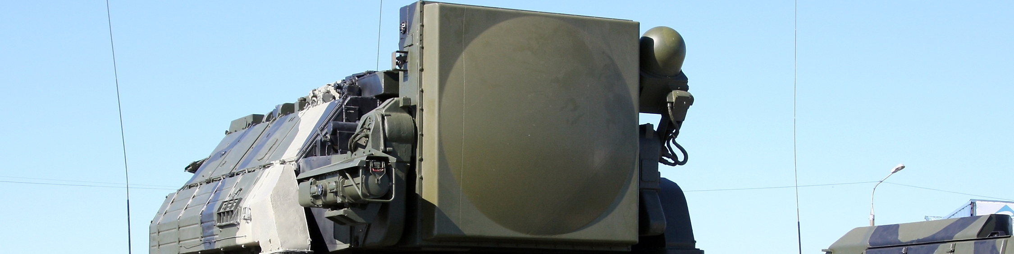
sead

Slide 52
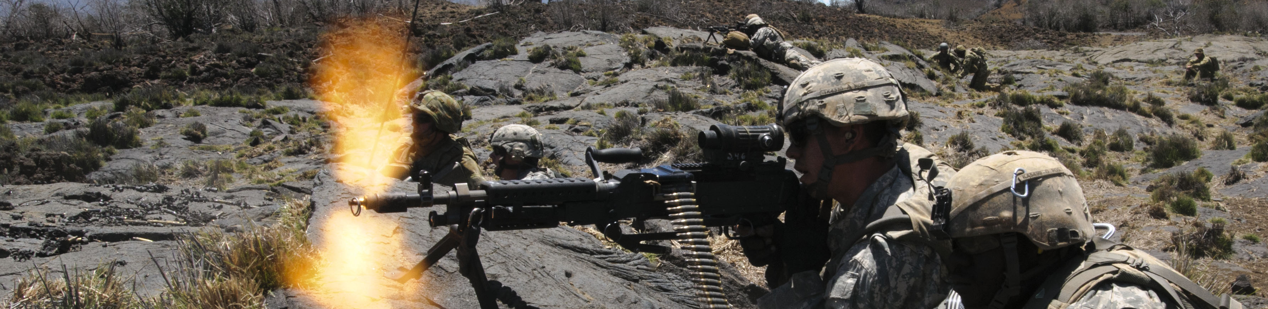
suppression

Slide 53

capture zones

Slide 54
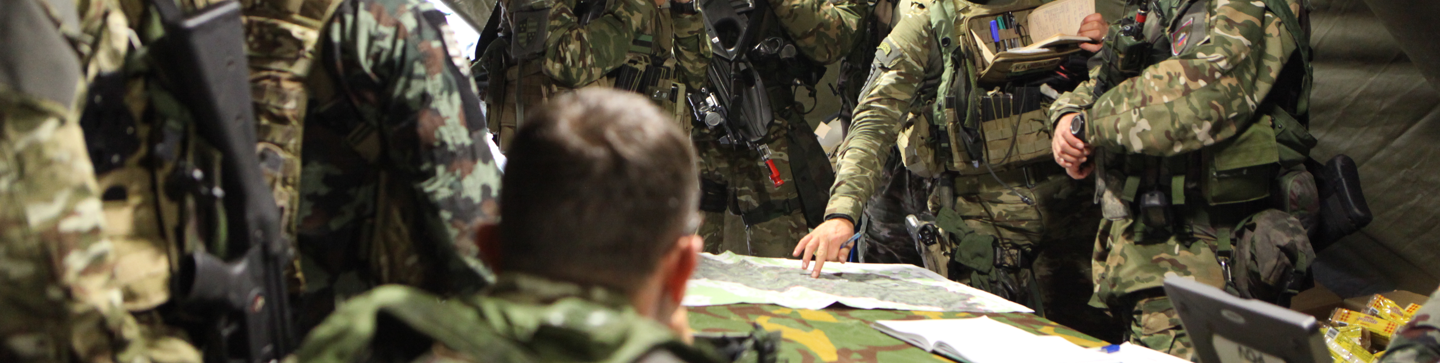
task - mission

Slide 55
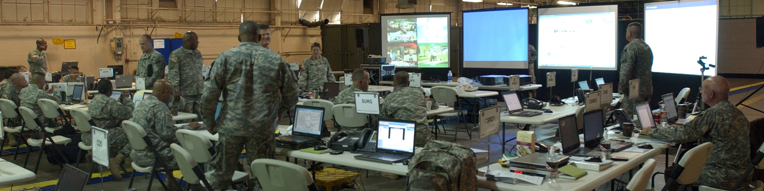
task - command center

Slide 56

tasking - detection manager

Slide 57
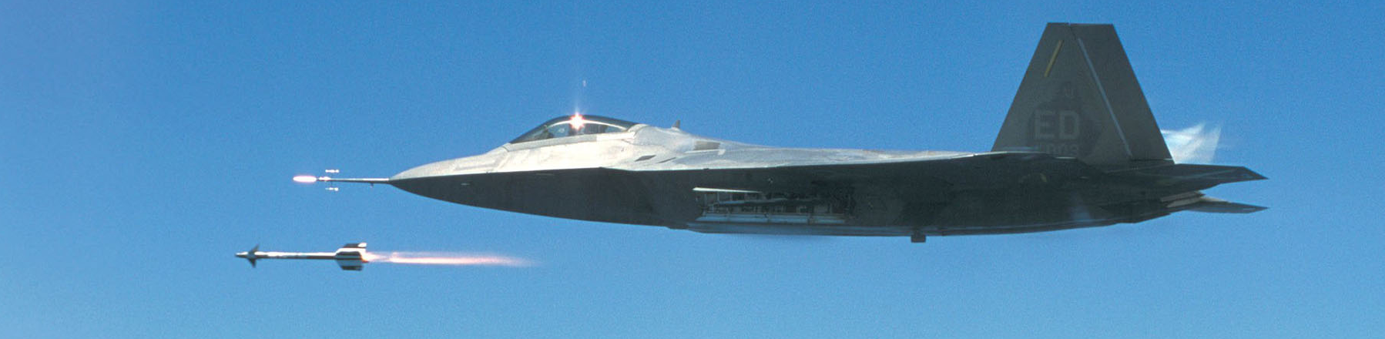
tasking - A2A task dispatcher

Slide 58
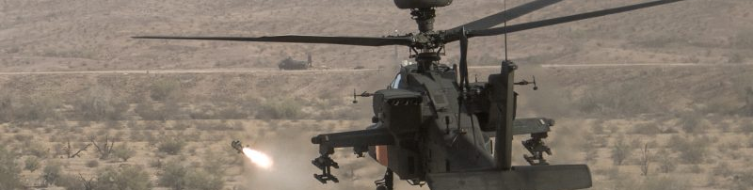
task - A2G dispatcher

Slide 59
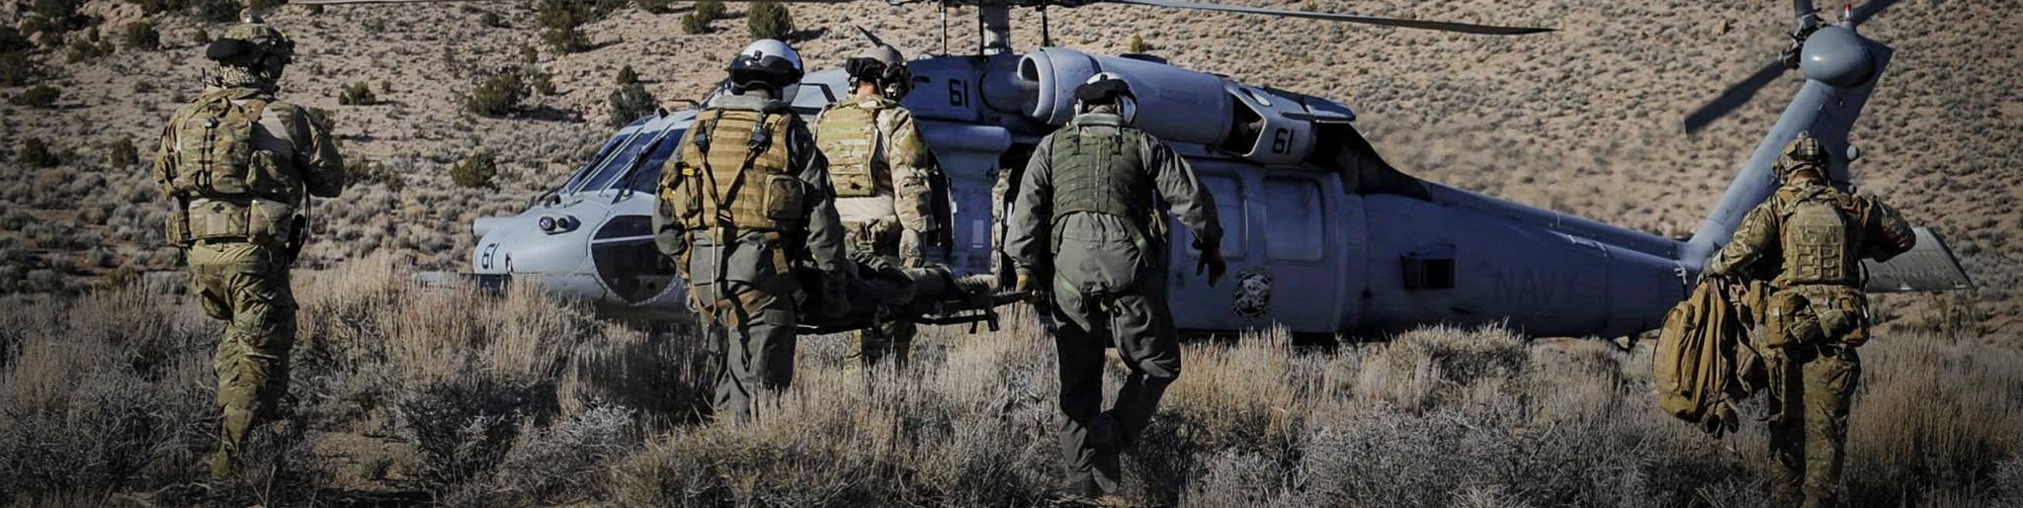
task - cargo csar

Slide 60
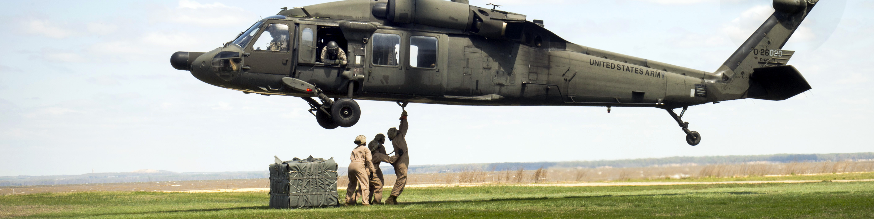
task - cargo transport

Slide 61
task - cargo dispatcher

Slide 62
task - cargo

Slide 63
task - manager

Slide 64
task - task

Slide 65
task - task info

Slide 66
task - task zone capture

Slide 67
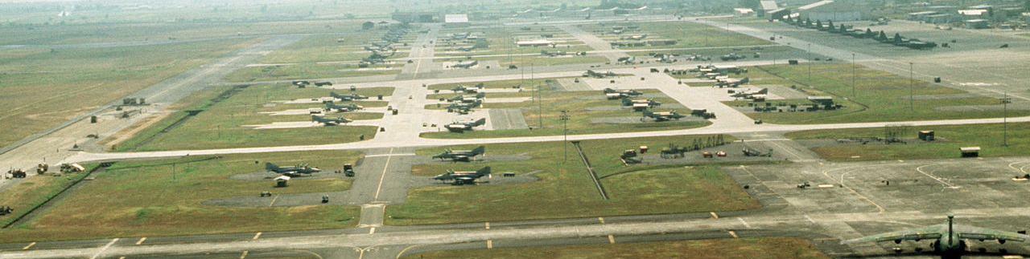
wrapper - airbase

Slide 68
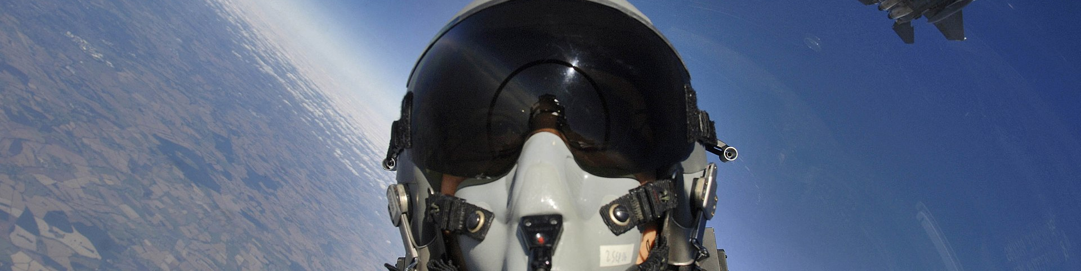
wrapper - client

Slide 69
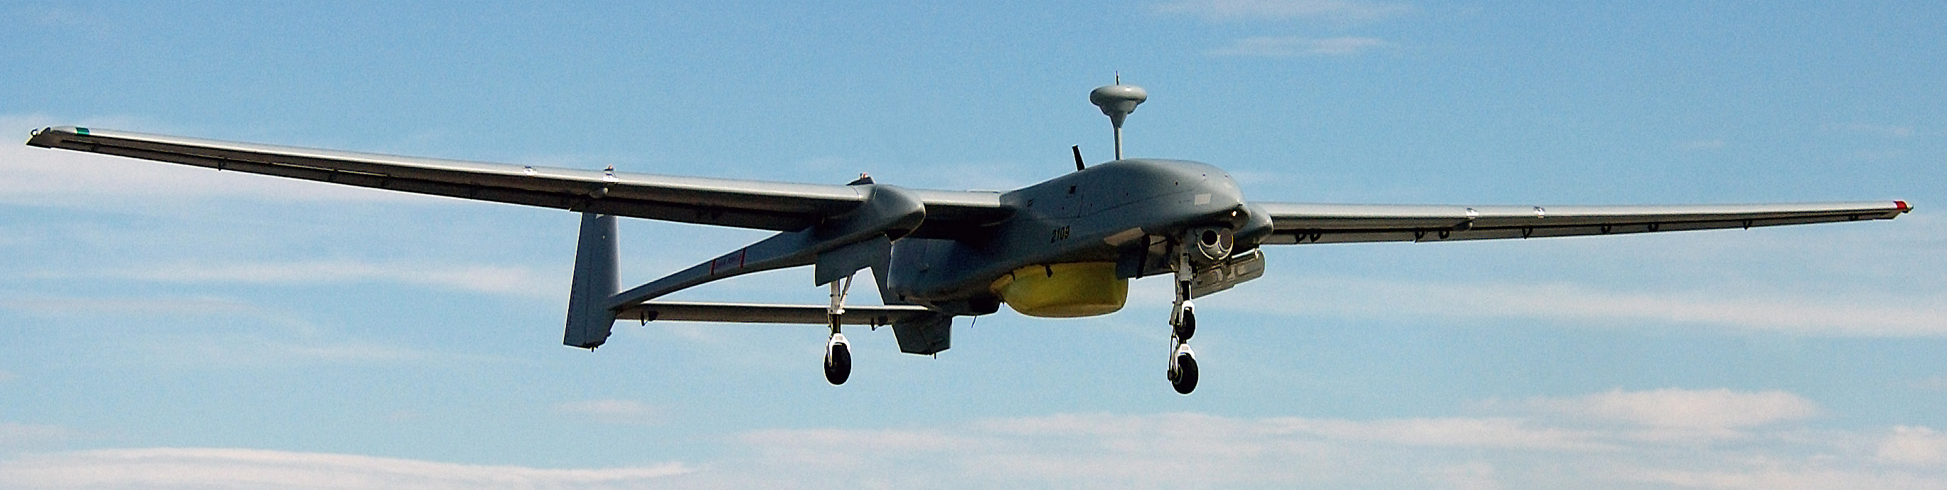
wrapper - controllable

Slide 70
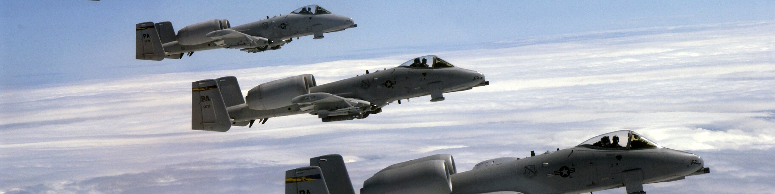
wrapper - group

Slide 71
wrapper - identifiable

Slide 72
wrapper - object

Slide 73
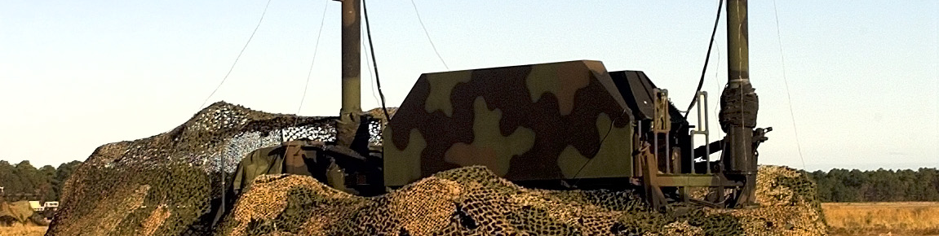
wrapper - positionable

Slide 74
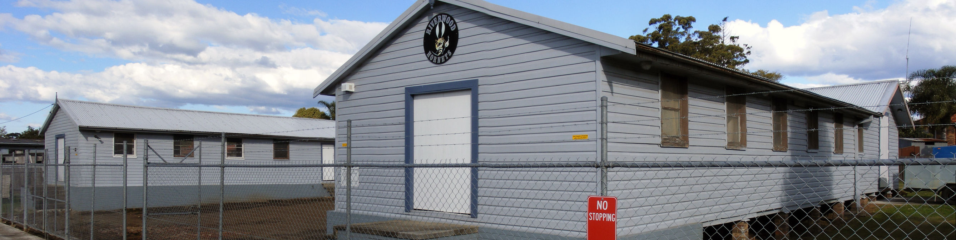
wrapper - scenery

Slide 75

wrapper - static

Slide 76

wrapper - unit

